Slide 1


Hepatic encephalopathy
Supervised by
Dr\ Nora Ramadan
Prepared by
Group A7

Slide 2
Prepared By\ Group (A7):
Ziad Yasser Abdelmawla
Abdulrahman Mohamad Ibrahim
Abdulrahman Mohamad Ahmed
Abdulrahman Mohamad Sayed
Abdulrahman Mahmoud Tawfiq
Abdulrahman Mones Othman
Abdulrahman Nasser Tawwba
Maryam Ahmed Abdel Moneim
Abdulrahman Abdelkarim
Shobak Maree Shobak
Sherine Wasfi Attia
Manar Taha Mahmoud
Hager Ehab Mahmoud
Shahd Mohamad Ali
Shahd Mohamad Mahmoud

Slide 3
Anatomy of the liver
The liver is located behind the ribs in the upper right portion of the abdominal cavity. It weighs about 1,500 g and is divided into four lobes. A thin layer of connective tissue surrounds each lobe,extending into the lobe itself and dividing the liver mass into small units called lobules.

Slide 4
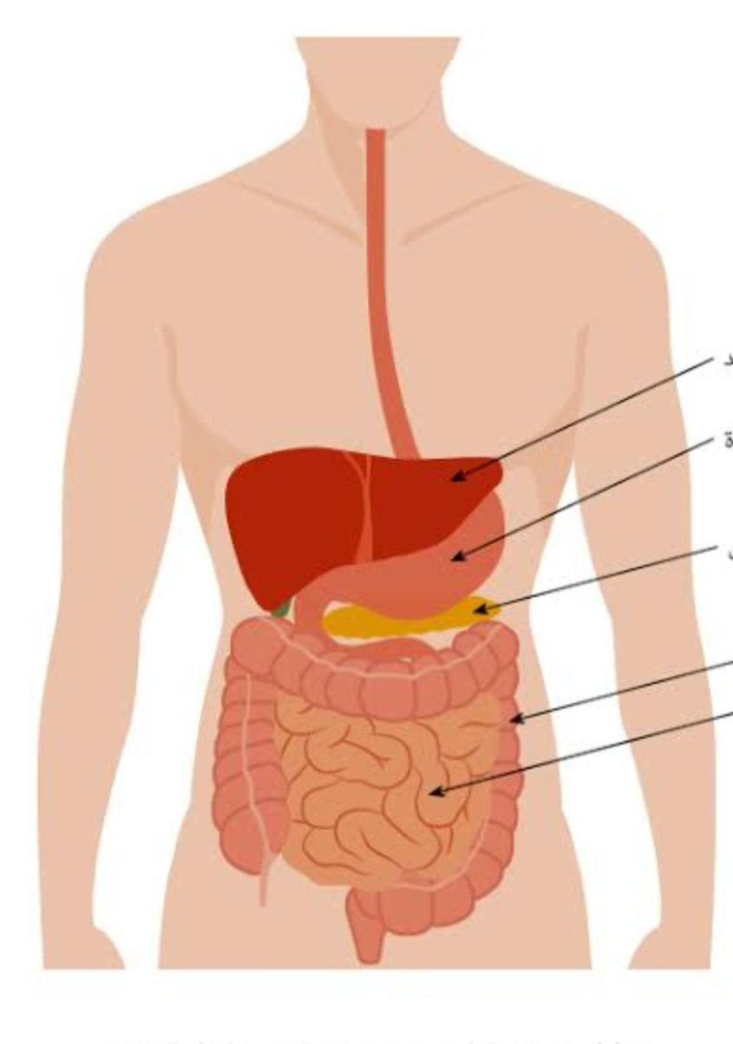
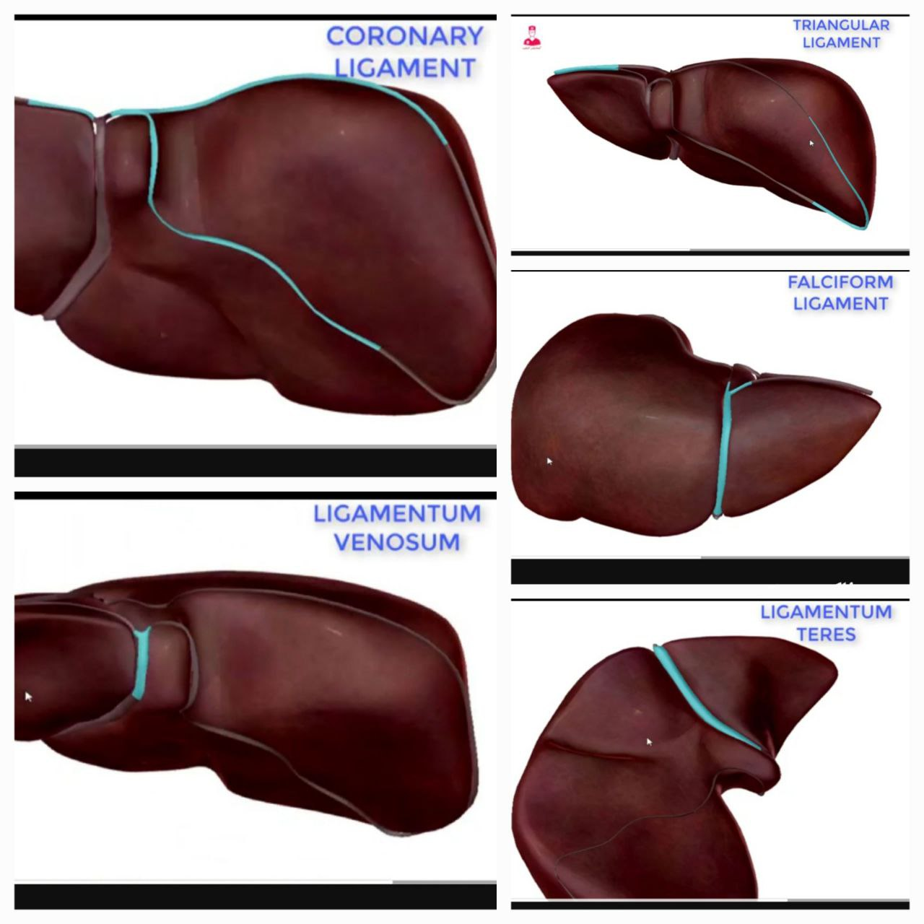
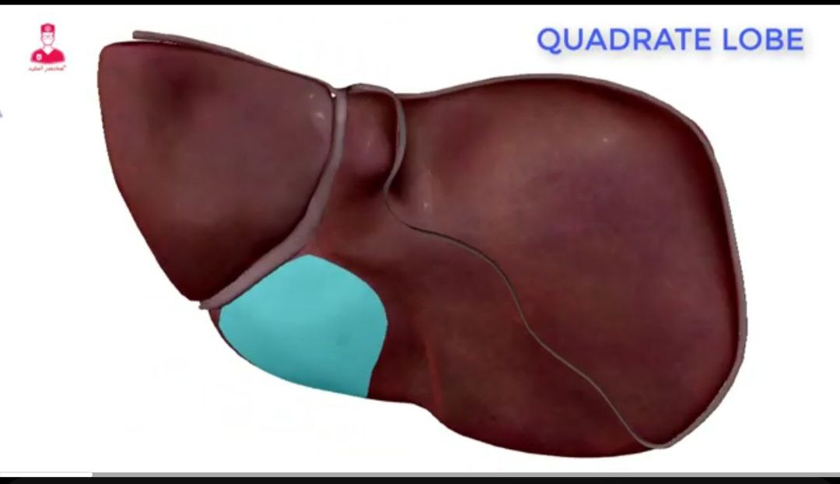
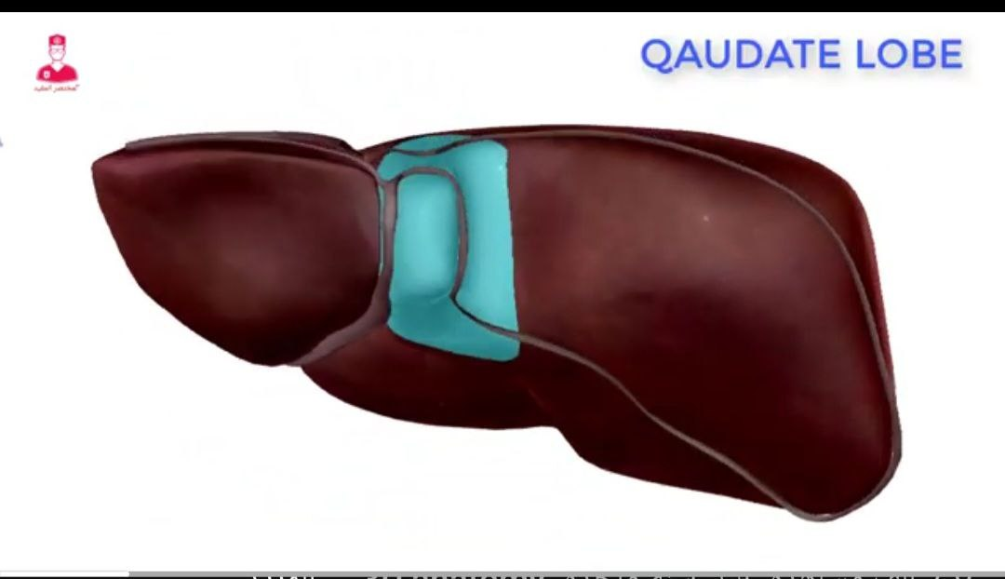
Anatomy of the liver

Slide 5
Hepatic circulation
The circulation of the blood into and out of the liver is of major importance in its function. The blood that perfuses the liver comes from two sources. Approximately 75% of the blood supply comes from the portal vein, which drains the GI tract and is rich in nu trients. The remainder of the blood supply enters by way of the hepatic artery and is rich in oxygen. Terminal branches of these two blood supplies join to form common capillary beds, which constitute the sinusoids of the liver Thus, a mixture of venous and arterial blood bathes the livercells (hepatocytes)

Slide 6
Hepatic circulation
The sinusoids empty into a venule that occupies the center of each liver lobule and is called the central vein. The central veins join to form the hepatic vein, which constitutes the venous drainage from the liver and empties into the inferior vena cava, close to the di aphragm. Thus, there are two sources of blood flowing into the liver and only one exit pathway In addition to hepatocytes, phagocytic cells belonging to the reticuloendothelial system are present in the liver. Other organs that contain reticulaendothelial cells are the spleen bone marrow.

Slide 7
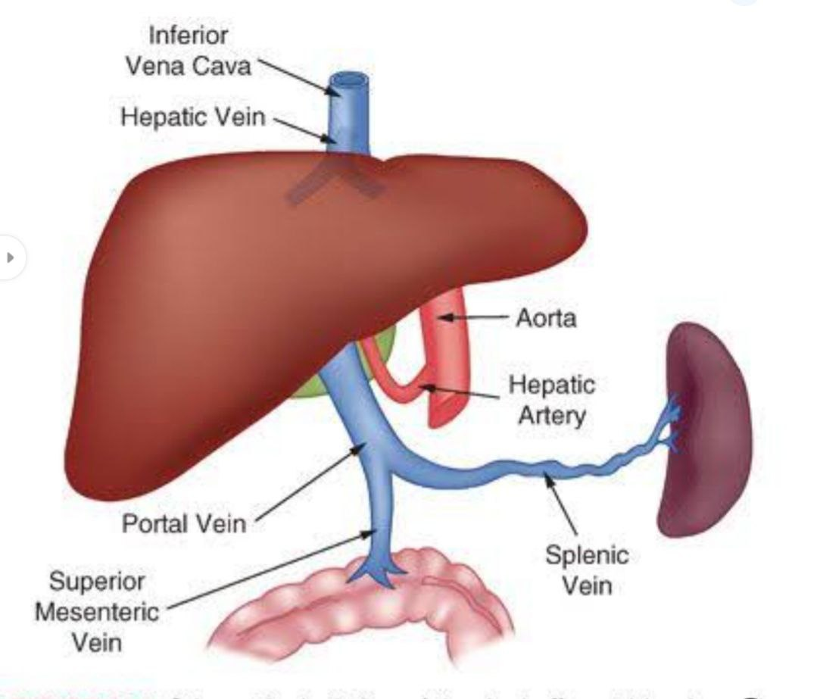
Hepatic circulation

Slide 8
Physiology of liver
The liver: the largest gland of the body, can be considered a chemical factory that manufactures, stores, alters, and excretes a large number of substances involved in metabolism. The location of the liver is essential in this function, because it receives nutrient-rich blood directly from the gastrointestinal (GI) tract and then either stores or transforms these nutrients into chemicals that are used elsewhere in the body for metabolic needs. The liver is especially important in the regulation of glucose and protein metabolism.

Slide 9
Physiology of liver
The liver manufactures and secretes bile, which has a major role in the digestion and absorption of fats in the GI tract. It removes waste products from the bloodstream and secretes them into the bile. The bile produced by the liver is stored temporarily in the gallbladder until it is needed for digestion, at which time the gallbladder empties and bile enters the intestine.

Slide 10
Function of the liver
• Glucose Metabolism : The liver plays a major role in the metabolism of glucose and the regulation of blood glucose concentration after a meal. Additional glucose can be synthesized by the liver through a process called gluconeogenesis.
• Ammonia Conversion : The liver converts this metabolically generated ammonia into urea.Remove ammonia that produced by bacteria in the intestine for urea synthesis .
• Fat Metabolism : The liver is also active in fat metabolism, Fatty acids can be broken down for the production of energy and the production of ketone bodies.Fatty acids and Their metabolic products are also used for the synthesis of cholesterol, lecithin, lipoproteins.
• Bile Formation : Bile is continuously formed by the hepatocytes and collected in the bile duct, It is composed mainly of water and electrolytes, and contains significant amounts of lecithin, Fatty acids, cholesterol, bilirubin, and bile salts. The function of bile duct are excretory and also aid in the digestion.

Slide 11
Function of the liver
• Protein Metabolism :The liver plays an important role in protein metabolism . It synthesizes almost all of the plasma proteins (except for gamma, globulin). Vitamin K is required by the liver for synthesis of prothrombin.
• Vitamin and Iron Storage : Vitamin A,B and D and Several of the B-complex vitamin are stored in large amounts in the liver. So that the liver extracts have been used for therapy for a wide large of nutritional disorders.
• Drug Metabolism : The liver metabolizes many medications. Metabolism generally results in loss of activity of the medication. One of the important pathway for medication metabolism involves conjugation (binding) of the medication. The conjugated products may be excreted in the feces or urine. If an oral medication (absorbed from the GI tract) is metabolized by the liver to a great extant before it reaches the systemic circulation; the amount of medication actually reaching the systemic circulation will be decreased.

Slide 12
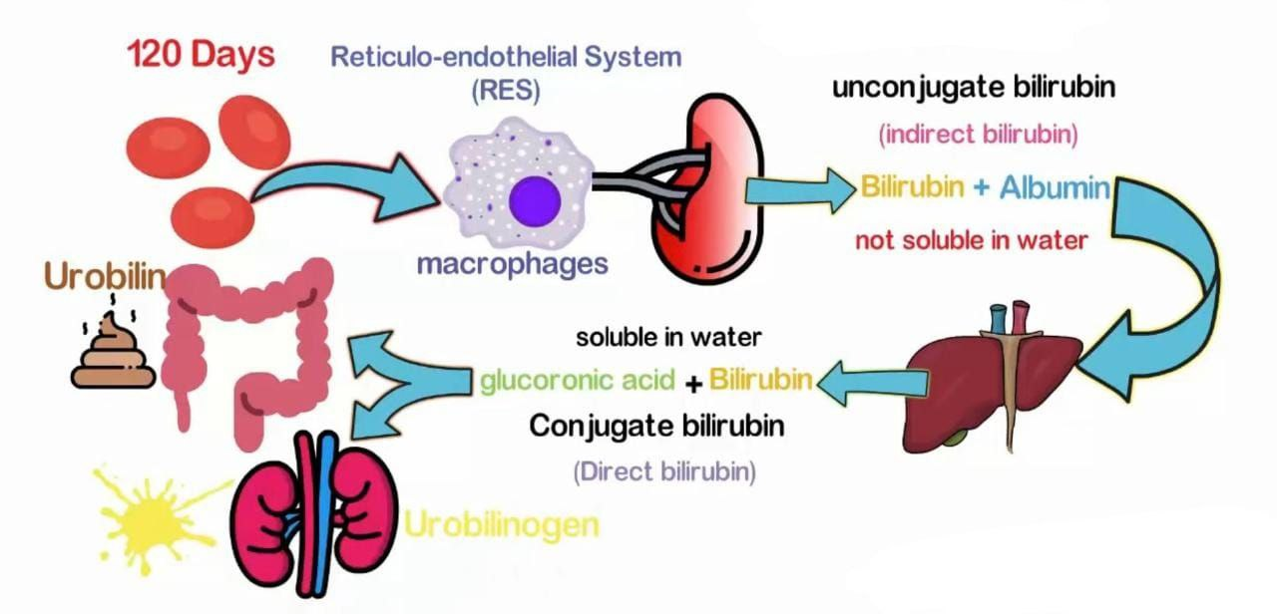
Function of the liver
Bilirubin Excretion : Bilirubin is pigment derived from the breakdown of the hemoglobin by cells of the reticuloendothelial system, including the kupffer cells of the liver.

Slide 13
Liver Cirrhosis
Cirrhosis is a chronic disease characterized by the replacement of normal liver tissue by diffuse fibrosis that disrupts liver structure and function. There are three types of cirrhosis or scarring of the liver:
• Alcoholic cirrhosis, in which scar tissue characteristically surrounds the portal areas. This is most often caused by chronic alcoholism and is the most common type of cirrhosis.
• Post-necrotic cirrhosis, where there are extensive areas of scar tissue as a late result of a previous bout of acute viral hepatitis.

Slide 14
Liver Cirrhosis
• Biliary cirrhosis, in which scarring of the liver occurs around the bile ducts. This type is usually the result of chronic bile duct obstruction and infection (cholangitis). It is less common than the other two types.
• The part of the liver mainly involved in cirrhosis consists of the entrance and the periportal spaces, where the bile ducts of each lobule continue to form the bile ducts of the liver. These areas become sites of inflammation, and the bile ducts become clogged with bile (thick) and pus. The liver tries to make new bile ducts. Thus, there is an overgrowth of tissue largely composed of detached and newly formed bile ducts that are surrounded by scar tissue.
• Clinical features include intermittent jaundice and fever. At first the liver is enlarged, hard and irregular, but But in the end atrophy

Slide 15
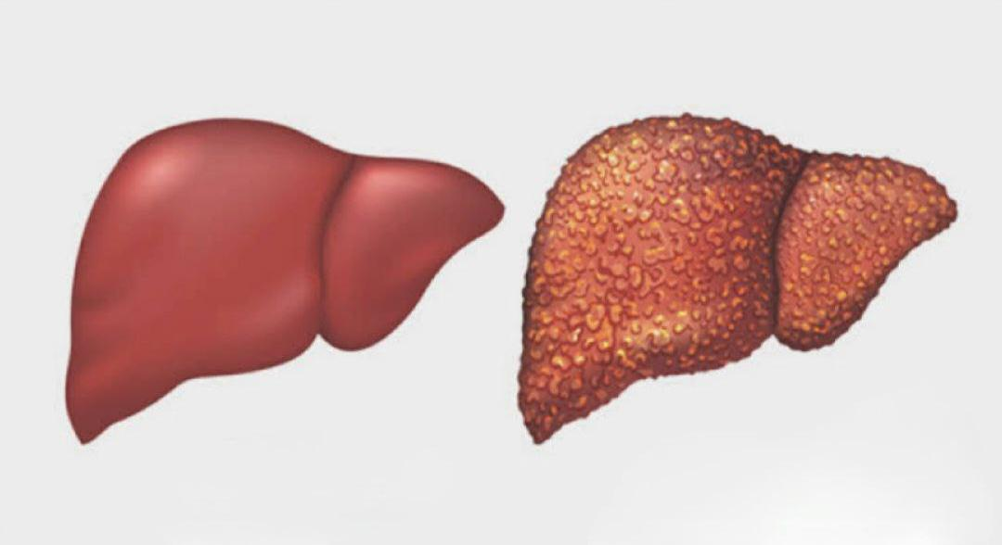
Liver Cirrhosis

Slide 16
Introduction
Hepatic encephalopathy (HE) or portosystemic encephalopathy (PSE) is a reversible syndrome of impaired brain function occurring in patients with advanced liver failure. However, HE is not a single clinical entity. It may reflect either a reversible metabolic encephalopathy, brain atrophy, brain edema or any combination of these conditions. The mechanisms causing brain dysfunction in liver failure are still unknown. These factors are directly related to liver failure (e.g. decreased metabolism of ammonia). Unless the underlying liver disease is successfully treated, HE is associated with poor survival and a high risk of recurrence. Even in its mildest form, HE reduces health-related quality of life and is a risk factor for bouts of severe HE.

Slide 17
THE DEFINITION
Hepatic encephalopathy is abrain dysfunction that can occur as a result of liver Disease or liver failure. The liver plays an important role in removing toxins from the Bloodstream, but if the liver is damaged, it may not be able to perform this function effectively.As a result,toxins such as ammonia ,which is normally converted into urea by the liver, can build up in the bloodstream and travel to the brain When these toxins reach the brain, they can cause a range of symptomsincluding confusion, difficulty concentrating, mood changes,disorientation,and insevere cases

Slide 18
THE DEFINITION
Coma or death.Hepatic encephalopathy can be acute or chronic and may occur in people with a variety of liver diseases, including cirrhosis,hepatitis,and liver cancer Treatment for hepatic encephalopathy typically involves managing the underlying liver disease, reducing the levels of toxins in the bloodstream through medications, and making dietary changes to limit the intake of protein. In some cases, liver transplant may be necessary to address the underlying liver disease and prevent further progression of hepatic encephalopathy.

Slide 19
Pathophysiology
Pathophysiology is the study of how diseases or abnormalities in the body cause physiological changes that lead to symptoms and signs of illness. It involves the study of the functional and structural changes that occur in the body as a result of disease or injury. In simpler terms, it's the study of how diseases disrupt the normal functions of the body. Ammonia accumulates because damaged liver cells fail to detoxify and convert to urea the ammonia that is constantly entering the bloodstream. Ammonia enters the bloodstream as a result of its absorption from the GI tract and its liberation from kidney and muscle cells.

Slide 20
Pathophysiology
The increased ammonia concentration in the blood causes brain dysfunction and damage, resulting in hepatic encephalopathy. Circumstances that increase serum ammonia levels tend to aggravate or precipitate hepatic encephalopathy. The largest source of ammonia is the enzymatic and bacterial digestion of dietary and blood proteins in the GI tract. Ammonia from these sources is increased as a result of GI bleeding (ie, bleeding esophageal varices or chronic GI bleeding), a high-protein diet, bacterial infections, and uremia. The ingestion of ammonium salts also increases the blood ammonia level.

Slide 21
Pathophysiology
In the presence of alkalosis or hypokalemia, increased amounts of ammonia are absorbed from the GI tract and from the renal tubular fluid. Conversely, serum ammonia is decreased by elimination of protein from the diet and by the administration of antibiotic agents, such as neomycin sulfate, that reduce the number of intestinal bacteria capable of converting urea to ammonia (Dudek, 2001). Other factors unrelated to increased serum ammonia levels that may cause hepatic encephalopathy in susceptible patients include excessive diuresis, dehydration, infections, surgery, fever, and some medications (sedative agents, tranquilizers, analgesic agents, and diuretic medications that cause potassium loss).

Slide 22
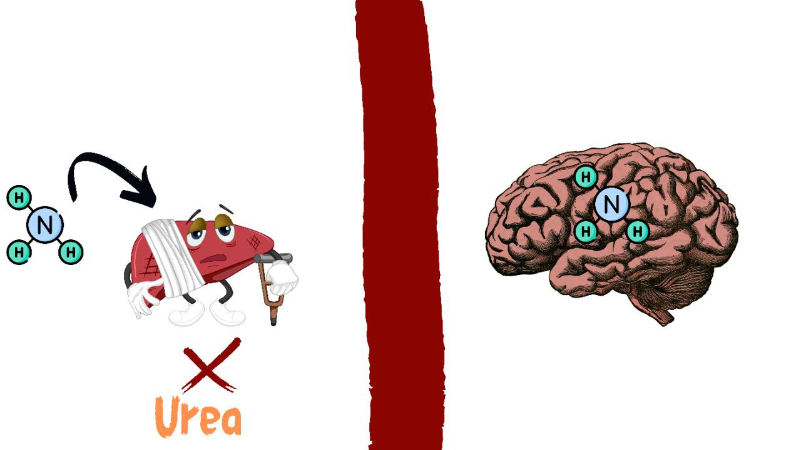
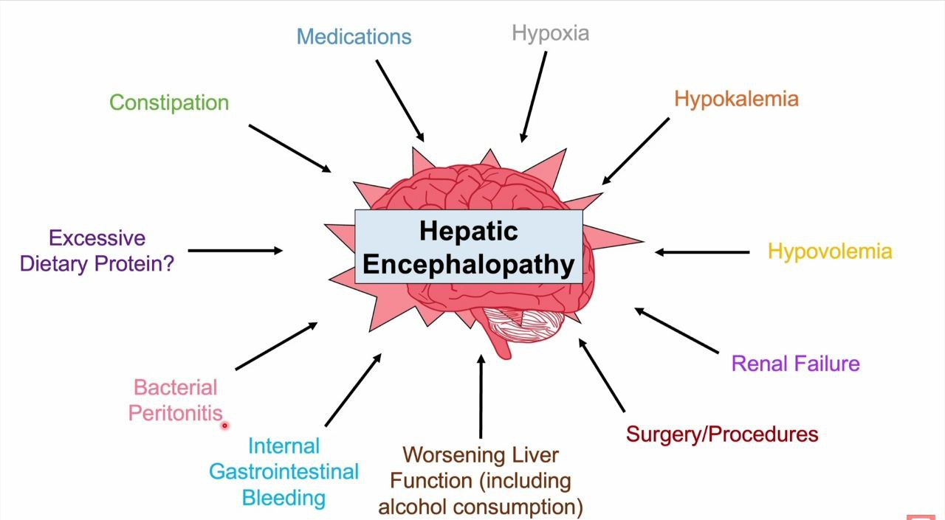
Pathophysiology

Slide 23
Clinical manifestations
The clinical manifestations of hepatic encephalopathy can vary depending on the severity of condition. Some of the common signs and symptoms of hepatic encephalopathy include:
1. Changes in behavior and personality:
• Confusion.
• Alterations in mood.
• Unkempt.
• Disorientation.
2. Cognitive problems:
• Difficulty in concentrating.
• Difficulty with problem-solving or decision-making.

Slide 24
Clinical manifestations
3. Sleep problems:
• Alterations in sleep patterns.
• Tendency to sleep during the day.
• Insomnia at night.
• Difficult to awaken.
4. Physical symptoms:
• Asterixis (flapping tremor of the hands).

Slide 25
Clinical manifestations
• Problem in performing tasks such as handwriting and drawing sample. become difficult (eg. Star figure). this is called constructional apraxia.
• In the early stages of hepatic encephalopathy, the deep tendon reflexes are hyperactive, with worsening of hepatic encephalopathy become flaccid.
❖ If you or someone you know experiences any of these symptoms, it's important to seek medical attention immediately. Early diagnosis and treatment can help prevent the condition from progressing to more severe stages.

Slide 26
Assessment and Diagnostic Findings
The electroencephalogram (EEG) shows generalized slowing:
an increase in the amplitude of brain waves ,characteristic triphasic waves.
Occasionally, fetor hepaticus, a sweet, slightly fecal odor to the breath presumed to be of intestinal origin may be noticed. The odor has also been described as similar to that of freshly mowed grass, acetone, or old wine.

Slide 27
Assessment and Diagnostic Findings
Fetor hepaticus is prevalent with extensive collateral portal circulation in chronic liver disease.
In a more advanced stage, there are gross disturbances of consciousnesses and the patient is completely disoriented with respect to time and place.
With further progression of the disorder, the patient lapses into frank coma and may have seizures.
Approximately 35% of all patients with cirrhosis of the liver die in hepatic coma.

Slide 28
Medical Management
Lactulose (Cephulac) is administered to reduce serum ammonia levels.
-It acts by several mechanisms that promote the excretion of ammonia in the stool.
(1) ammonia is ept in the ionized state, resulting in a fall in colon pH, reversing the normal passage of ammonia from the colon to the blood.
(2) evacuation of the bowel takes place, which decreases the ammoniaabsorbed from the colon.
(3) the fecal flora are changed to organisms that do not produce ammonia from urea.

Slide 29
Medical Management
-Two or three soft stools per day are desirable; this indicates that lactulose is performing as intended.
-NURSING ALERT The patient receiving lactulose is monitored closely for the development of watery diarrheal stools, because they indicate a medication overdose
-Possible side effects include intestinal bloating and cramps, which usually disappear within a week. -To mask the sweet taste,to which some patients object, lactulose can be diluted with fruit juice.
The patient is closely monitored for hypokalemia and dehydration

Slide 30
Medical Management
-Other laxatives are not prescribed during lactulose administration because their effects would disturb dosage regulation.
-Lactulose can be administered by nasogastric tube or enema for
patients who are comatose or in whom oral administration is contraindicated or impossible.
-Other aspects of management include
1-intravenous administration of glucose to minimize protein breakdown
2-administration of vitamins to correct deficiencies, and correction of
electrolyte imbalances (especially potassium).

Slide 31
Medical Management
-Additional principles of management of hepatic encephalopathy include the following: *Therapy is directed toward treating or removing the cause. • Neurologic status is assessed frequently. A daily record is kept of handwriting and performance in arithmetic to monitor mental status.
• Fluid intake and output and body weight are recorded each day.
• Vital signs are measured and recorded every 4 hours.
• Potential sites of infection (peritoneum, lungs) are assessed frequently, and abnormal findings are reported promptly.
• Serum ammonia level is monitored daily.

Slide 32
Medical Management
• Protein intake is restricted in patients who are comatose or who have encephalopathy that is refractory to lactulose and antibiotic therapy.
• Reduction in the absorption of ammonia from the GI tract is accomplished by the use of gastric suction, enemas, or oral antibiotics.
• Electrolyte status is monitored and corrected if abnormal.
• Sedatives, tranquilizers, and analgesic medications are discontinued.
• Benzodiazepine antagonists (flumazenil [Romazicon]) may be administered to improve encephalopathy whether or not the patient has previously taken benzodiazepines

Slide 33
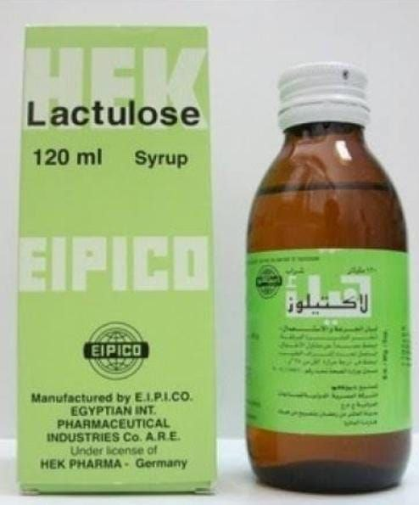
Medical Management

Slide 34
Stages of Hepatic Encephalopathy and Possible Nursing Diagnoses
STAGE | CLINICAL SYMPTOMS | CLINICAL SIGNS AND EEG CHANGES | SELECTED POTENTIAL NURSING DIAGNOSES
1 | Normal level of consciousness with periods of lethargy and euphoria; reversal of day–night sleep patterns. | Asterixis; impaired writing and ability to draw line figures. Normal EEG. | Activity intolerance Self-care deficit Disturbed sleep pattern.
2 | Increased drowsiness; disorientation; inappropriate behavior; mood swings; agitation. | Asterixis; fetor hepaticus. Abnormal EEG with generalized slowing. | Impaired social interaction Ineffective role performance Risk for injury.
3 | Stuporous; difficult to rouse; sleeps most of time; marked confusion; incoherent speech. | Asterixis; increased deep tendon reflexes; rigidity of extremities. EEG markedly abnormal. | Imbalanced nutrition Impaired mobility Impaired verbal communication.
4 | Comatose; may not respond to painful stimuli. | Absence of asterixis; absence of deep tendon reflexes; flaccidity of extremities. EEG markedly abnormal. | Risk for aspiration Impaired gas exchange Impaired tissue integrity Disturbed sensory perception.
*Nursing diagnoses are likely to progress, so that most nursing diagnoses present at earlier stages will occur during later stages as well.*

Slide 35
Nutritional mangement of hepatic encephalopathy
Prevent the formation and absorption of toxins, principally ammonia, from the intestine .
• Keep daily protein intake between 1.0 and 1.5 g/kg, depending on the degree of decompensation .
• Avoid protein restriction if possible, even in those with encephalopathy. If necessary, implement temporary restriction of 0.5 g/kg .
• For patients who are truly protein-intolerant, provide additional nitrogen in the form of an amino acid supplement. Use of branched-chain amino acids is still controversial.
.Provide small, frequent meals and an evening snack of complex carbohydrates to avoid protein loading .
• Substitute vegetable protein for animal protein in as high a percentage as possible.

Slide 36
Management Modalities and Nursing Care for the Patient
Management Modalities and Nursing Care for the Patient
Treatment modality | Action | Nursing priority
Nonsurgical Modalities
Pharmacologic agentsVasopressin (Pitressin) | Reduces portal pressure by constricting splanchnic arteries | Observe response to therapy. Monitor for side effects:vasopressin—angina; nitroglycerin may beprescribed to prevent or treat angina.
Propranolol (Inderal)/nadolol (Corgard) | Reduces portal pressure by Β-adrenergic blocking action | propranolol and nadolol—decreased pulse, pressure, impaired cardiovascular response to hemorrhage.
Somatostatin/octreotide (Sandostatin) | Reduces portal pressure by selective vasodilation of portal system | Explain procedure to patient briefly to obtain Cooperation with insertion and maintenance of esophageal tamponade tube and reduce patient’s fear of the procedure.
Balloon tamponade | Exerts pressure directly to bleeding sites in Esophagus and stomach | Monitor closely to prevent inadvertent removal or displacement of tube, subsequent airway obstruction, and aspiration. Provide frequent oral hygiene.
Room-temperature saline lavage | Clears blood and secretions before endoscopy and other procedures | Ensure patency of the nasogastric tube to prevent aspiration.
Injection sclerotherapy | Promotes thrombosis and | Observe for aspiration, perforation of the

Slide 37
Management Modalities and Nursing Care for the Patient
 | sclerosing of bleeding Ing sites by injection of sclerosing agent into the esophageal varices |  |  | Esophagus, and recurrence of bleeding after treatment.
Variceal banding |  | Provides thrombosis and mucosal necrosis of Bleeding sites by band ligation | Observe for recurrence of bleeding,Esophageal perforation.
Transjugular intrahepatic portosystemic shunting (TIPS) |  | Reduces portal pressure by creating a shunt Within the liver between the portal and Systemic venous system. | Observe for rebleeding and signs of infection.
Surgical Modalities
Portal-systemic shunting |  | Reduces portal hypertension by diverting blood flow away from obstructed portal system | Observe for development of portal-systemic Encephalopathy (altered mental status, neurologic dysfunction), hepatic failure,and rebleeding.
Surgical ligation of varices Esophageal transection and devascularization |  | Ties off blood vessels at the site of bleeding separates bleeding site from portal system | Requires intensive, expert nursing care for prolonged period.Observe for rebleeding.Provide postthoracotomy care

